Slide 1
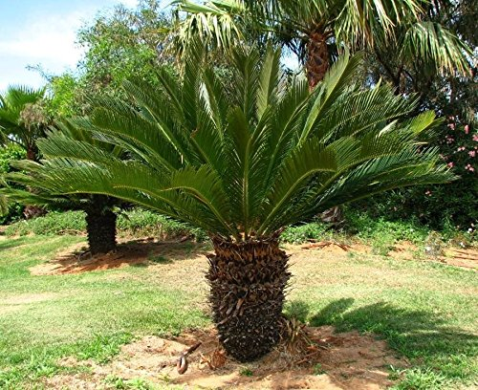
LIFE CYCLE OF CYCAS
Prativa Deka
Assoc. Prof.
Dept. of Botany
Mangaldai College

Slide 2
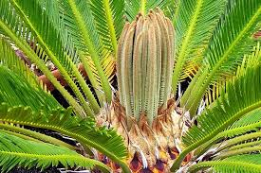
Systematic Position
Class-Cycadopsida
Order-Cycadales
Family-Cycadaceae
Genus-Cycas

Slide 3
Distribution of Indian species
Out of 20 spp 5 spp grow in India
Cycas circinalis L.-South India
C. beddomei Dyer-Andhra Pradesh
C. pectinata Griff-Eastern India
C. rumphii Miq.-Andaman and Nicobar Islands
C. revoluta Thunb.-Japanese sp widely cultivated as ornamental plant in India

Slide 4
General morphology
Stem - Stout, generally unbranched bearing a crown of leaves at the top, bears adventitious buds at the base
Leaves - two kinds: small brown scale leaves and large pinnately compound foliage leaves.
Root - Tap root system. Coralloid roots or corallorhiza formed from some apo-geotropic roots which are inhabited by Anabaena cycadacearum a blue green alga

Slide 5
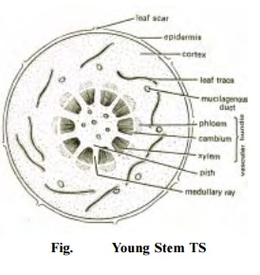
Anatomy of stem
The stem anatomy of Cycas is simple and shows some primitive features. It shows the following tissues:-
1. Epidermis
2. Cortex
3. Endodermis, Pericycle and Vascular Cylinder
4. Medullary rays
5. Pith

Slide 6
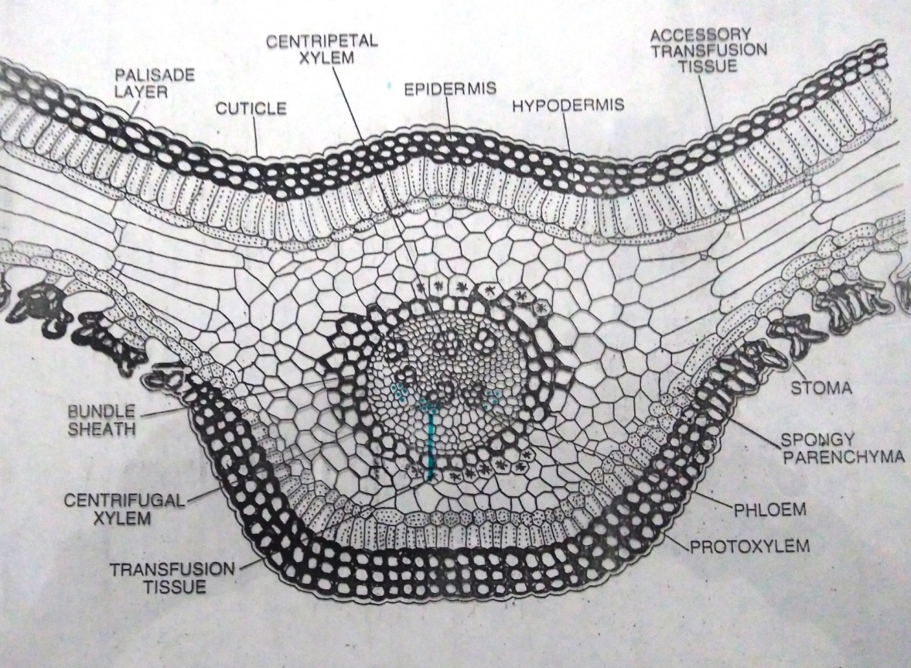
Anatomy of Leaf
A transverse section of leaflet shows the following tissues;-
1.Cuticle
2.Epidermis
3.Hypodermis
4.Mesophyll Tissue
5.Transfusion Tissue
6.Vascular Bundle
7.Primaary transfusion Tissue

Slide 7
Sexual Reproduction
l

Slide 8
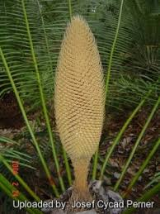
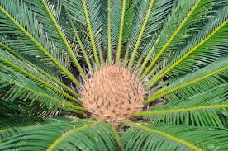
All living Cycas are dioecious. The microsporophylls are aggregated into large compact strobili or cones. But the megasporophylls are losely arranged. They do not form a true cone.
l

Slide 9
Structure of male cone
Male cone is a long, compact, spindle-shaped structure. It has a central woody axis.
Several microsporophylls are spirally arranged around the axis.
Each microsporophyll is woody flattened wedged-shaped structure.
It bears hundred of microsporangia on its lower surface in clusters of three to six.

Slide 10
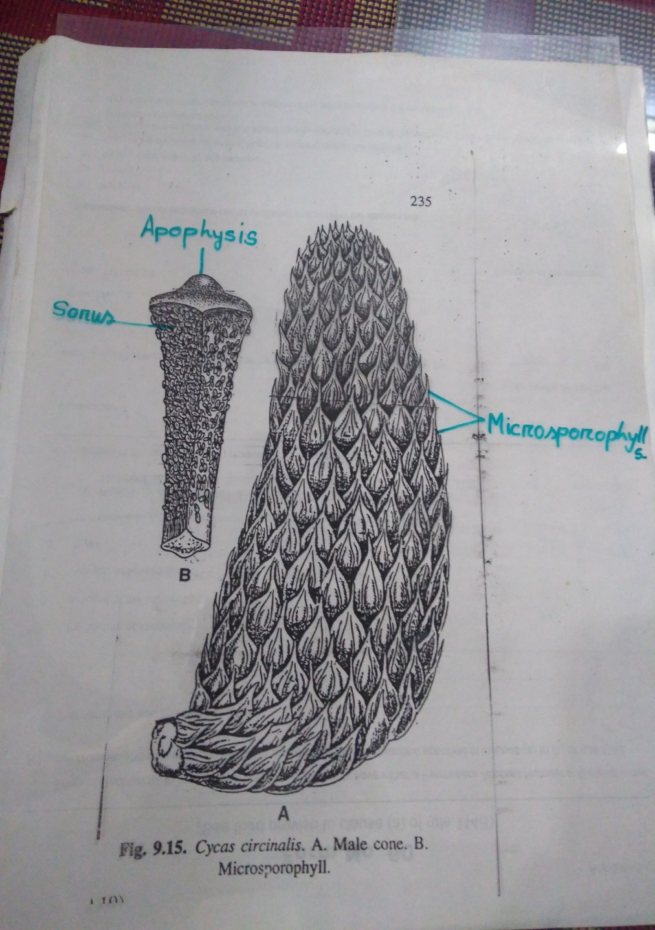
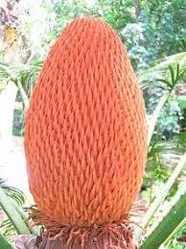

Slide 11
Structure of female strobilus
There is no true and compact female cone in Cycas.
A crown of megasporophylls spirally arised in acropetal succession at the apex of the stem.
The megasporophylls are large and divided into an upper broad leafy portion and a lower stalk like portion.
The leafy portion is more or less pinnately lobed, tapering to a point.
Ovules are borne laterally on the lower stalk-like portion which are vary in number from two to ten.

Slide 12
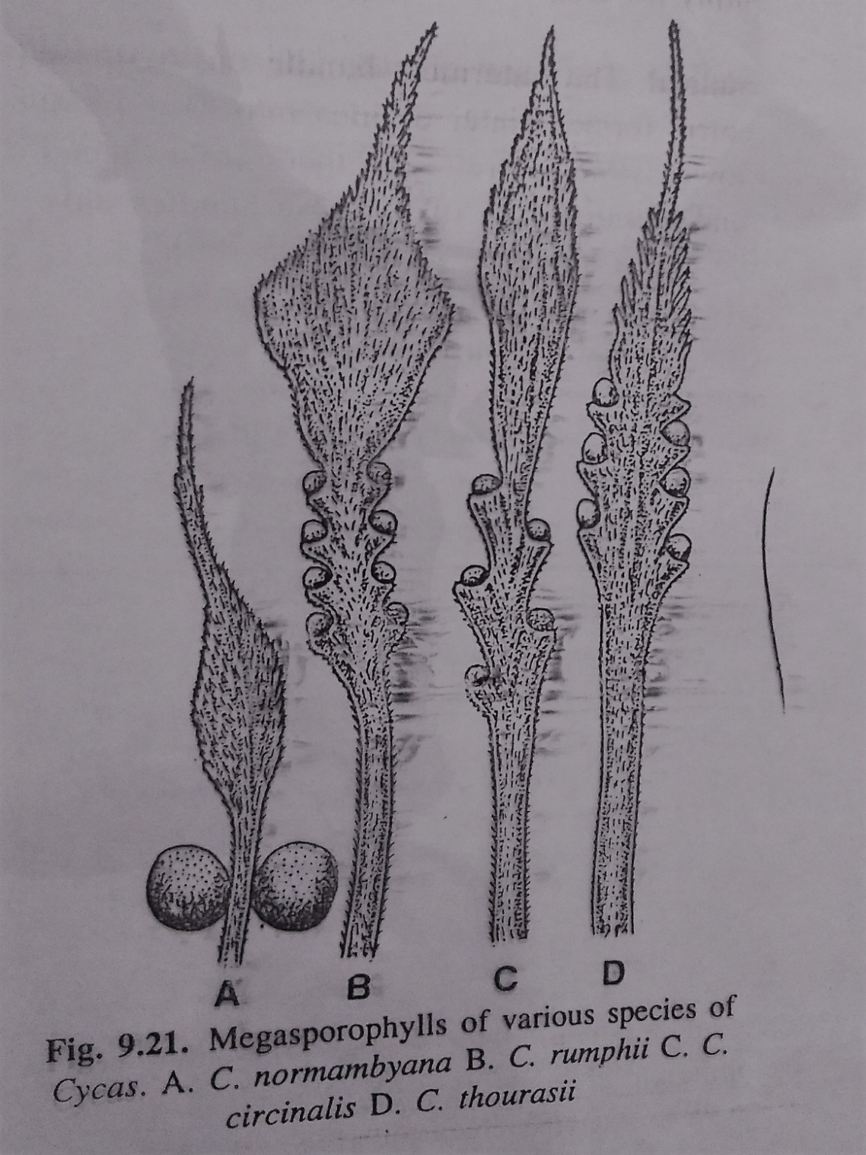

Slide 13
Structure of ovule

Slide 14
Gametophytic generation

Slide 15
Development of Male Gametophyte
These developmental changes can be grouped under two main heads:
A. Developmental changes before pollination
Development of Microspore
Cell division in the Microspore
Pollination
B. Developmental changes after pollination
Formation of stalk and body cell
Development of the pollen tube
Formation of the male gametes

Slide 16
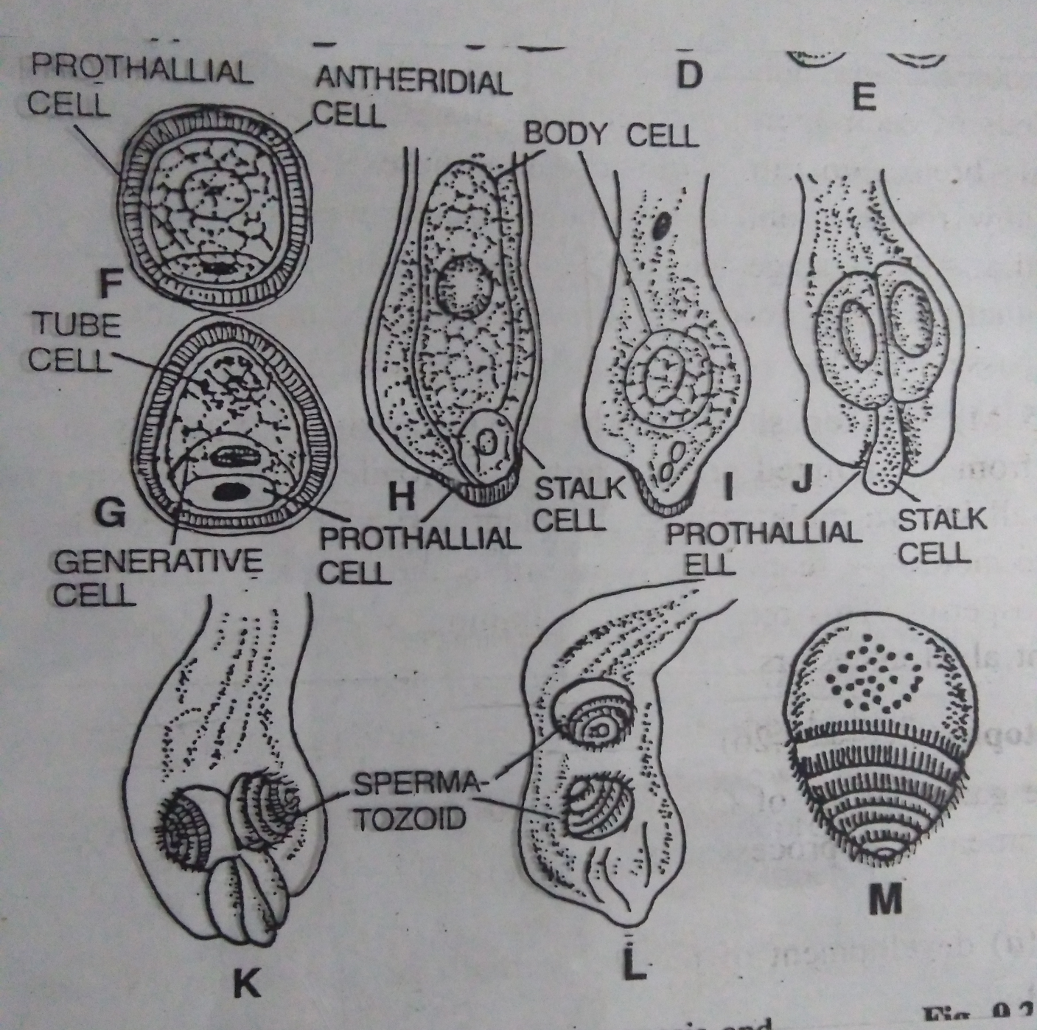
Fig. Development of male gametophyte

Slide 17
Development of Female Gametophyte
The development of female gametophyte of Cycas is monosporic.
These process can be divided into following heads:
1.Formation of megaspore
2.Development of female prothallus
3. Development of archegonia

Slide 18
Fertilization
After the formation of archegonia the pollen tube burst and discharge its contents into the archegonial chamber.
The sperms swim within the archegonial chamber.
One of them swims to an archegonium, enters it and makes its way down the egg.
Then the sperm fuses with the female nucleus.

Slide 19
Conclusion
The Cycads are obviously primitive plants.
They bear many resemblance with the group Cycadofilicales or cycad ferns.
Cycadofilicales were abundant in the coal period and are now extinct.
The living Cycads resemble these plants in many respects and hence called the “living fossils.”

Slide 20
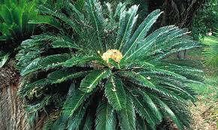
Thanks

